Slide 1
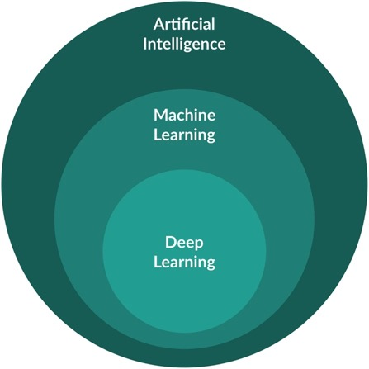
Machine Learning
08.10.21

Slide 2
Overview
Artificial Intelligence - Any technique that enables computers to mimic human intelligence, using logic, if-then rules, etc.
Machine Learning
Statistical Machine Learning:
- Regression
- Decision Trees
- Bayesian Learning
- K-means Clustering
- Support Vector Machines
Neural Networks:
- Multi-layered, fully connected
- Auto-encoders
Deep Learning:
- Convolutional Neural Networks
- Recurrent Neural Networks
- Long Short-Term Memory
S. Samudrala (2018)

Slide 3
Overview
Artificial Intelligence - Any technique that enables computers to mimic human intelligence, using logic, if-then rules, etc.
Machine Learning
Statistical Machine Learning:
- Regression
- Decision Trees
- Bayesian Learning
- K-means Clustering
- Support Vector Machines
Neural Networks:
- Multi-layered, fully connected
- Auto-encoders
Deep Learning:
- Convolutional Neural Networks
- Recurrent Neural Networks
- Long Short-Term Memory
S. Samudrala (2018)

Slide 4
Some Terminology
Nature of the Problem:
Regression:
Variables are continuous numerical values (e.g. temperatures)
Classification:
Variables can adopt one of several possible values (e.g. grades)
Clustering:
Grouping of data into a specified number of cohesive units
Variables:
Feature Variables = Input Variables
Label Variables = Output Variables
Solving Methods:
Parametric Models:
Each input is given a weightage parameter based on their influence on the output (e.g. linear regression)
Non-Parametric Models:
Output is derived from the output of the training data, based on closest data record or group of records (e.g. decision trees)
Learning Methods:
Supervised Learning:
Requires in- and output variables (e.g. linear regression)
Unsupervised Learning:
Requires only input variables (e.g. k-means clustering)
Reinforced Learning:
Requires risk/reward inputs from environment (e.g. games)
S. Samudrala (2018)

Slide 5
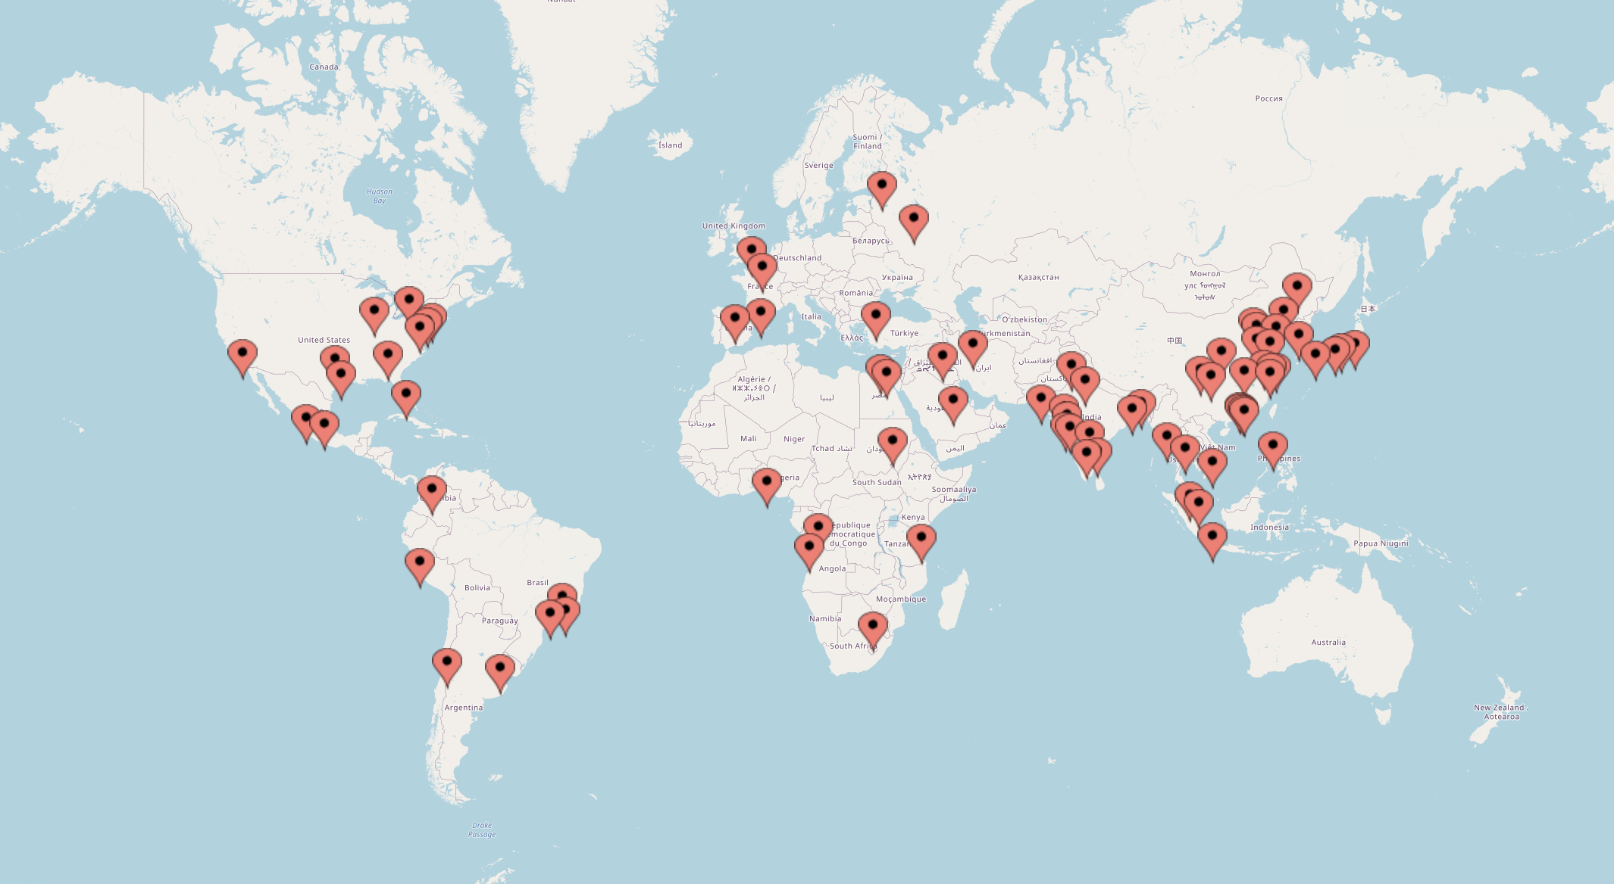
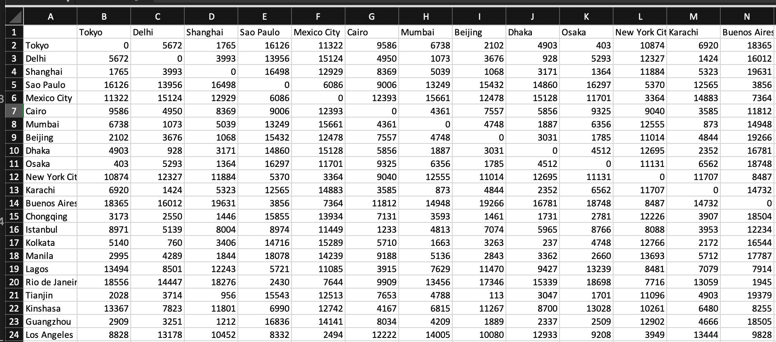
Example Data – Distances between Large Cities
81 Cities with a population over 5 million people
Can the cities be clustered based on the distances between them?
Should I put the R scripts on Rspace?
Table with distances between cities in km:

Slide 6
Data Pre-Processing
Models build on fewer feature variables usually generalize better, thus improving the quality of predictions
PCA can be used for dimensionality reduction
81 feature variables / dimensions
81 records
Blue indicates small and red large values

Slide 7
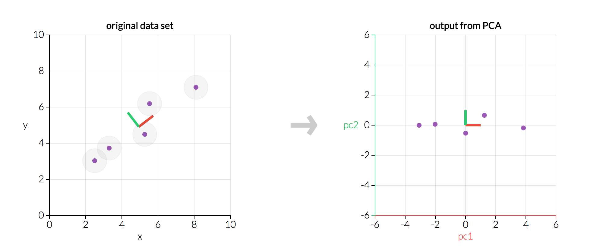
Principal Component Analysis (PCA)
PCA transforms feature variables into principal components based on their “information content”
Principal components (PCs) are ranked according to their “information content”
There are as many principal components as feature variables in the original data

Slide 8
PCA – Score Plots
Plots show combinations of the first 5 PCs of the PCA
Data was normalized before the PCA: The distances were divided by half of earth’s circumference to have “nicer” numbers

Slide 9
PC1 vs Sum of Distances
PC1 reflects mostly the “remoteness” of cities

Slide 10
Proportion of Variance
The first four principal components contain already 99.76 % of the variance found in the complete data set
81 feature variables can be reduced to just 4 without losing much information

Slide 11
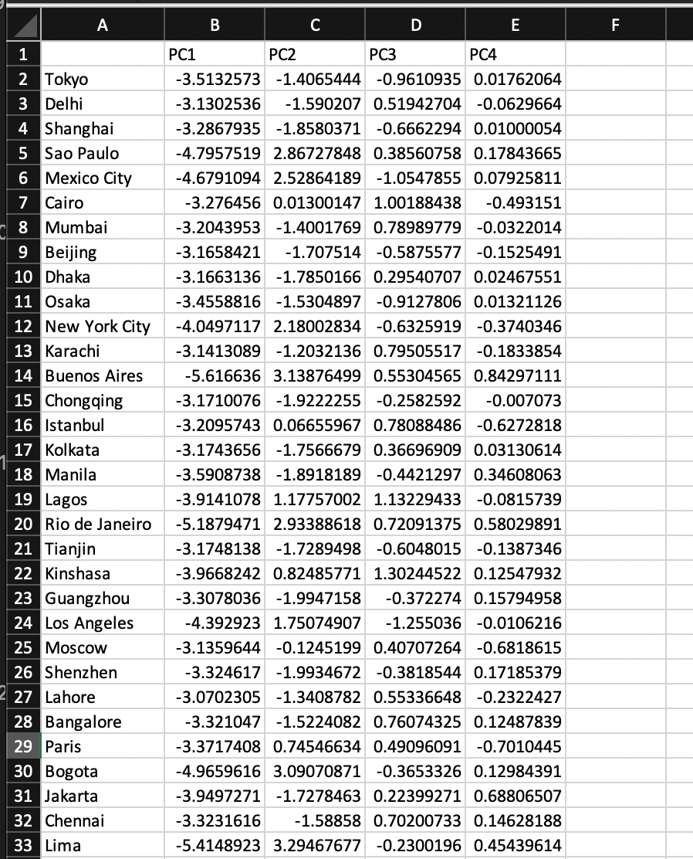
Pre-Processed Data
Each column is now a linear combination of the distances from before
This data can be used for further analysis using e.g. k-means clustering to group large cities

Slide 12
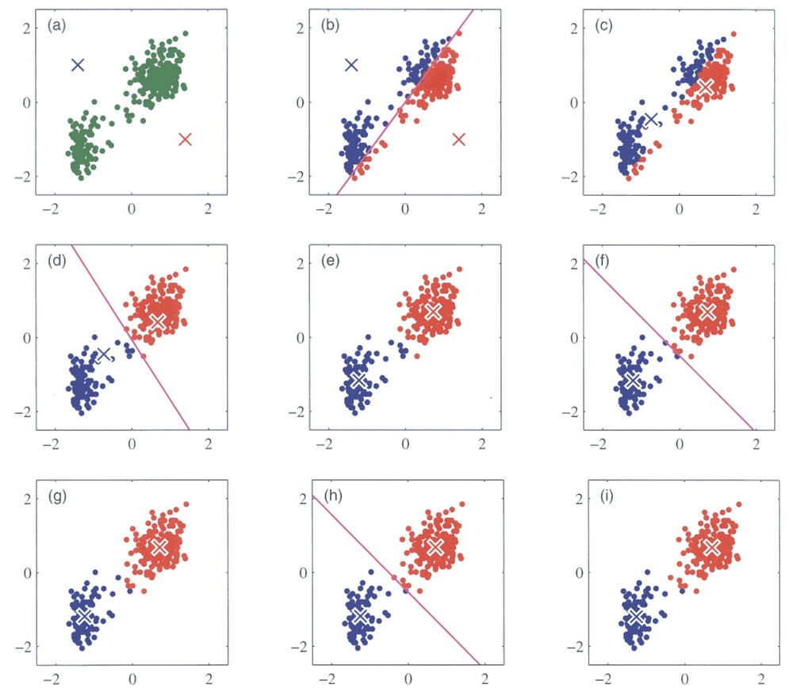
K-Means Clustering - Unsupervised Learning
Bishop 2006

Slide 13
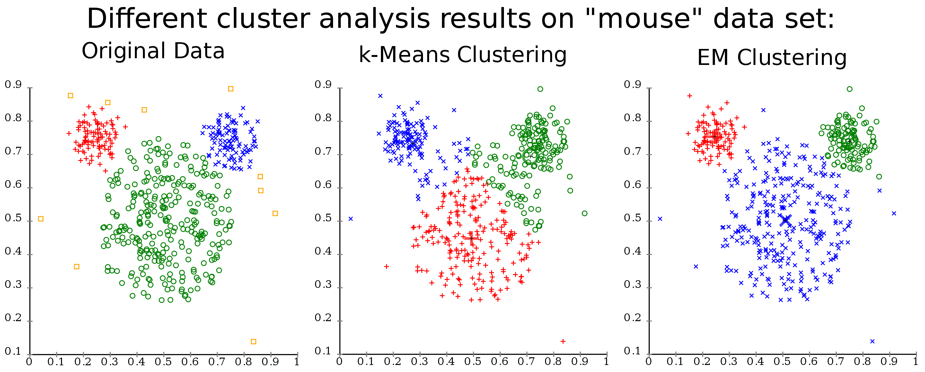
K-Means Clustering doesn’t work in every case
wikipedia

Slide 14
K-Means Clustering doesn’t work in every case
wikipedia

Slide 15
K-Means Clustering doesn’t work in every case
wikipedia

Slide 16
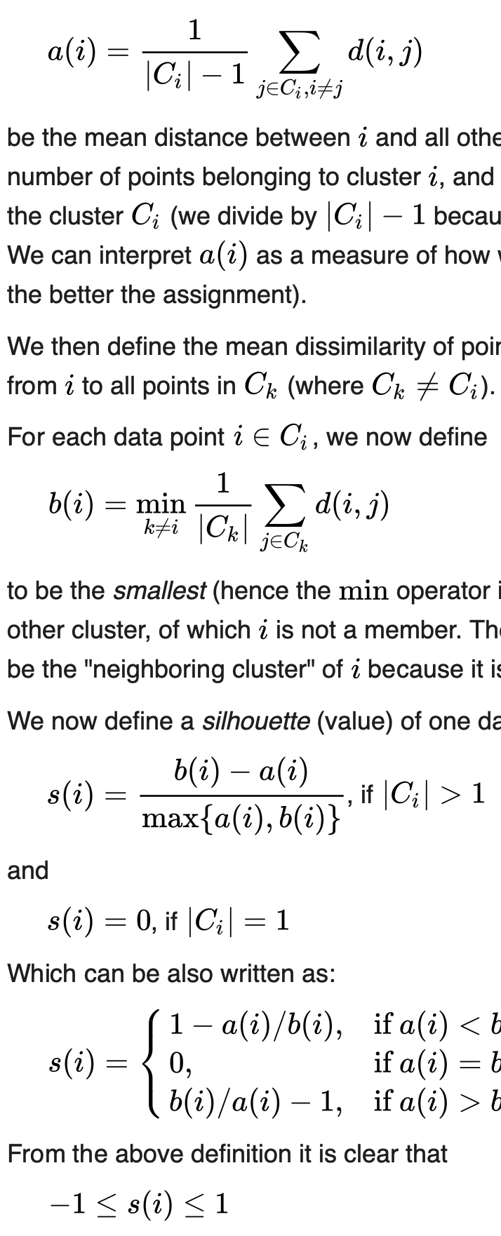
Average Silhouette Method for Optimal Cluster Number
“The silhouette value is a measure of how similar an object is to its own cluster (cohesion, a(i)) compared to other clusters (separation, b(i)). The silhouette ranges from −1 to +1, where a high value indicates that the object is well matched to its own cluster and poorly matched to neighboring clusters. If most objects have a high value, then the clustering configuration is appropriate. If many points have a low or negative value, then the clustering configuration may have too many or too few clusters.” - Wikipedia
C_{k}
C_{i}
b(i)
i
a(i)
The optimal number of clusters is based on the average silhouette of all data points, calculated for different cluster numbers. The optimal number of clusters should lead to the largest mean silhouette.
wikipedia

Slide 17
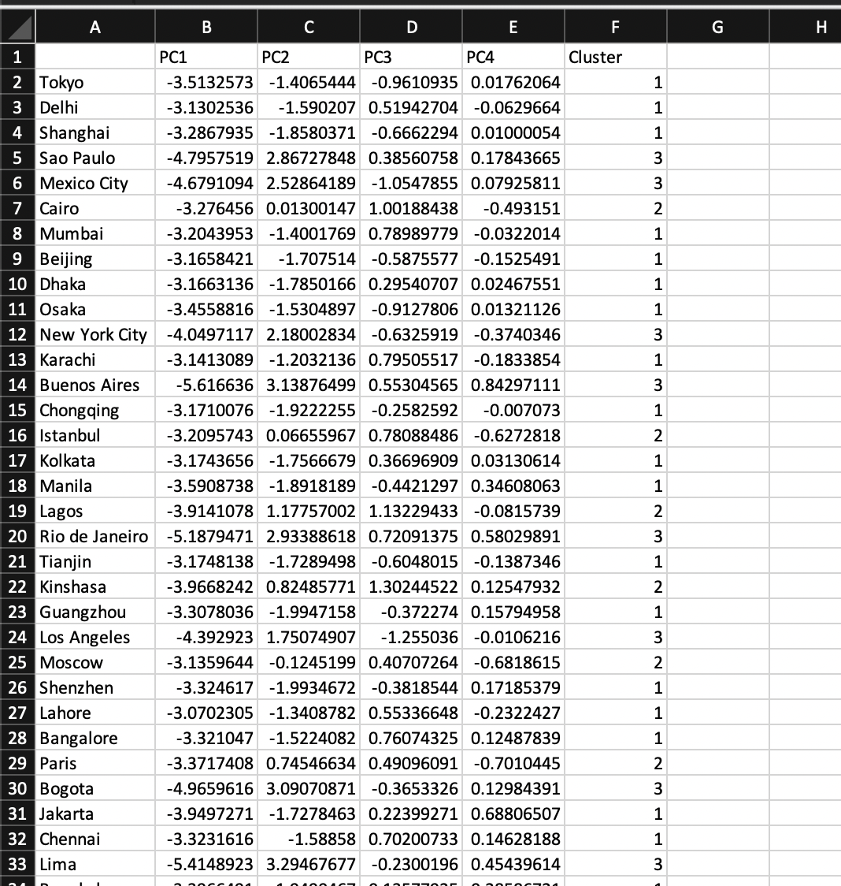
K-Means Clustering on City Data
Feature Variables
Label Variable
Three clusters seem to be optimal to group the cities

Slide 18
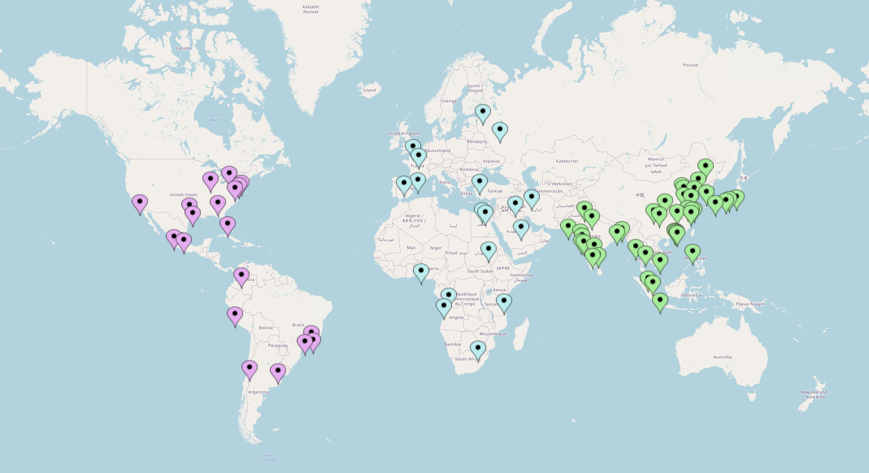
K-Means Clustering on City Data
Grouping in three clusters agrees with what could be intuitively grouped
Original distance table sorted according to the three clusters
Blue indicates small and red large values

Slide 19
PCA Plots with Cluster Information
The clustering seems to be determined in PC2
The clusters can be used as label variables to train other machine learning algorithms to assign cities to any of the three clusters

Slide 20
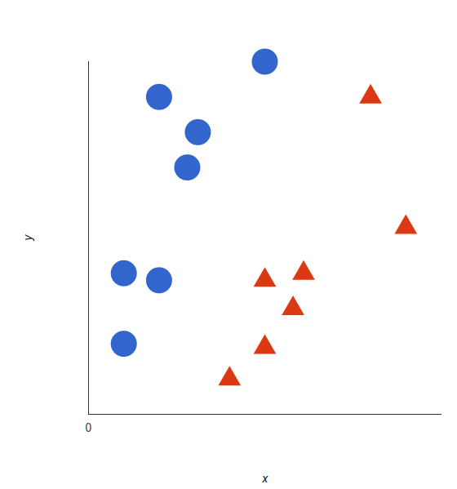
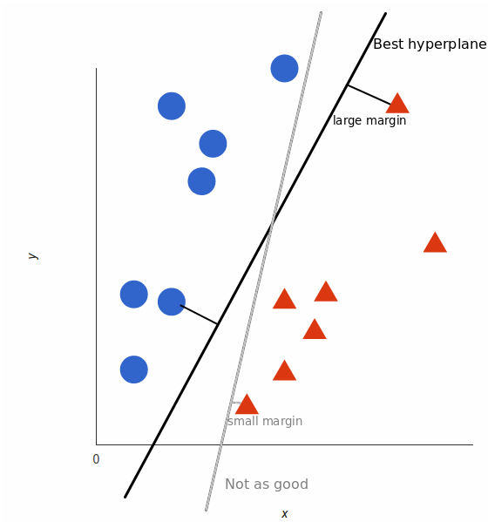
Support Vector Machine (SVM) for Classification
Hyperplane is introduced to separate two populations by the largest margin possible
Can be performed with any number of dimensions
datacamp

Slide 21
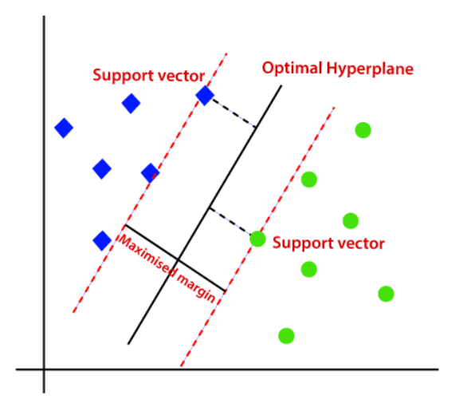
Support Vector Machine (SVM) for Classification
Hyperplane is defined by the nearest two points to either side (the support vectors)
SVM can be used for “hard” classifications. Every datapoint can be assigned to one of the populations without any probabilities
medium.com

Slide 22
SVM with City Data
Test data (NYC, Tehran, Karachi & Shanghai) was removed from training data
Tehran
NYC
Karachi
Shanghai
Hyperplanes between three groups were calculated in two rounds:
Group1 vs. non-Group1
Group3 vs non-Group3

Slide 23
SVM with City Data
Test data (NYC, Tehran, Karachi & Shanghai) was removed from training data
Tehran
NYC
Karachi
Shanghai
Test Cities can be assigned to corresponding clusters using SVM

Slide 24
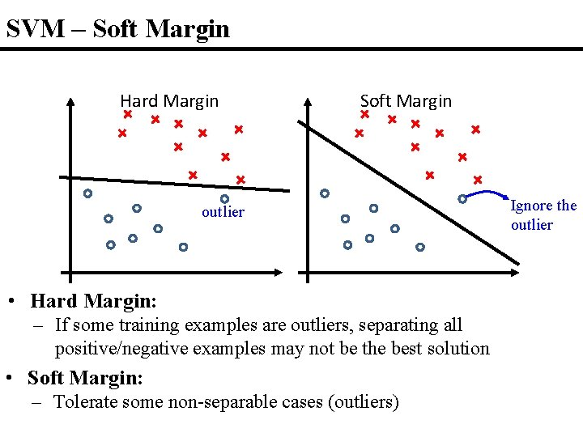
Hard vs Soft Margin SVM
slidetodoc.com

Slide 25
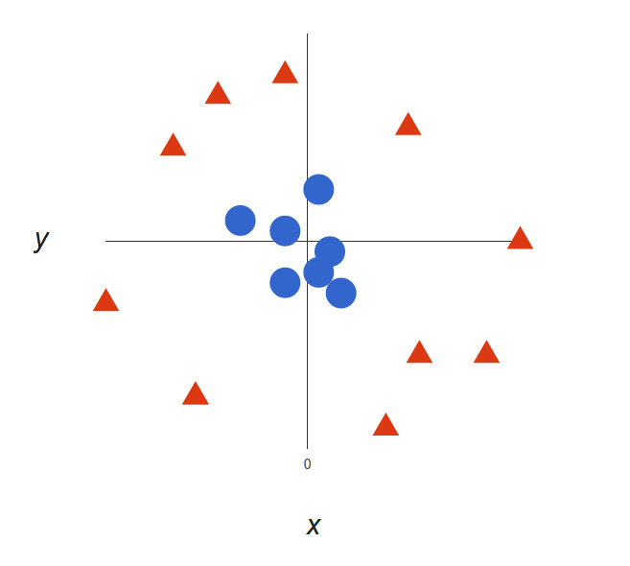
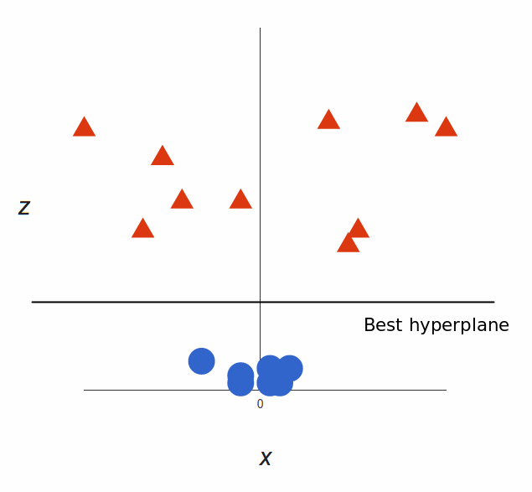
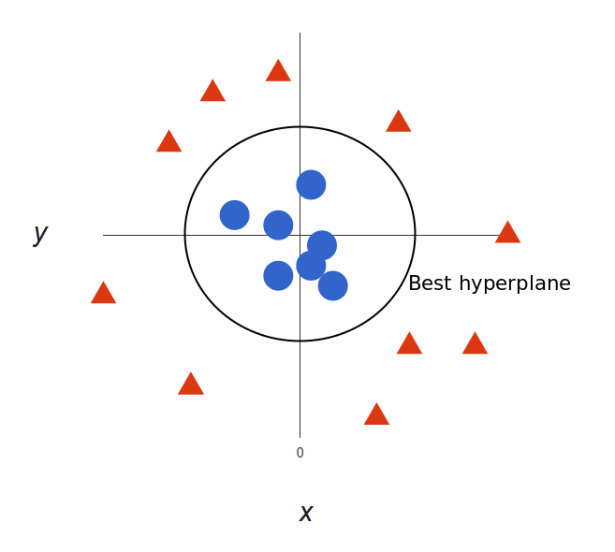
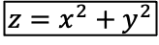
Non-linear SVM by Adding Dimensions
$$z=x^{2}+y^{2}$$
Non-linear SVM calculations are possible by combining multiple dimensions in the right way
Computationally, this can be a very expensive search since many possible combinations of dimensions are possible. This expensive search can be avoided by only considering scalar products of all data point pairs using the Kernel Trick.

Slide 26
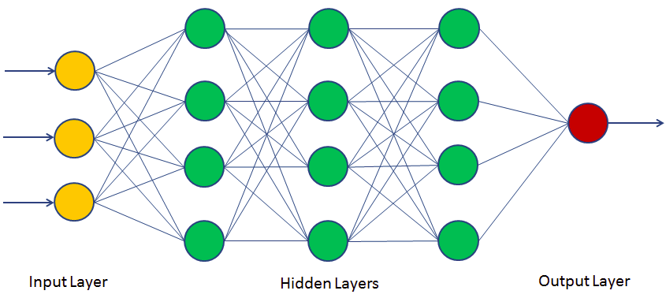
(Artificial) Neural Networks (NN)
The General Architecture of Neural Networks:
Feedforward: Neurons in one layer only connect to neurons in the next layer
Fully connected layers
As many input neurons as feature variables
Number of output neurons depend on the nature of the problem that needs to be solved (e.g. one for regression (if one label variable needs to be calculated), one or multiple for classification (corresponding to the number of classes))
datacamp

Slide 27
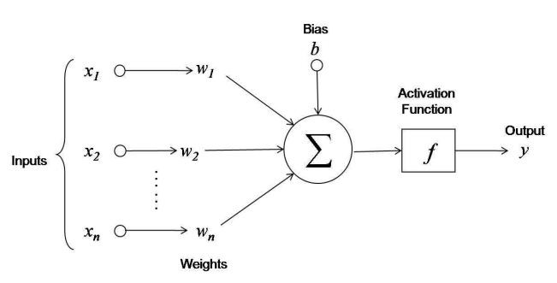
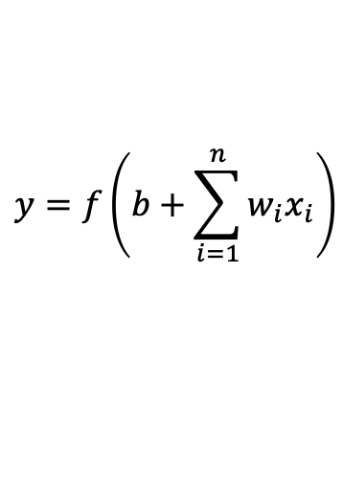
Nodes of Neural Networks
$$y=f\left(b+\sum_{i=1}^{n}{w_{i}x_{i}}\right)$$
Weights and biases are the only modifiable parameters during training. Together, they form the weight matrix.
These variables are adjusted during training to reduce the cost function (representing the difference between computed and expected output)
Input neurons just transmit feature variables without any mathematical operations

Slide 28
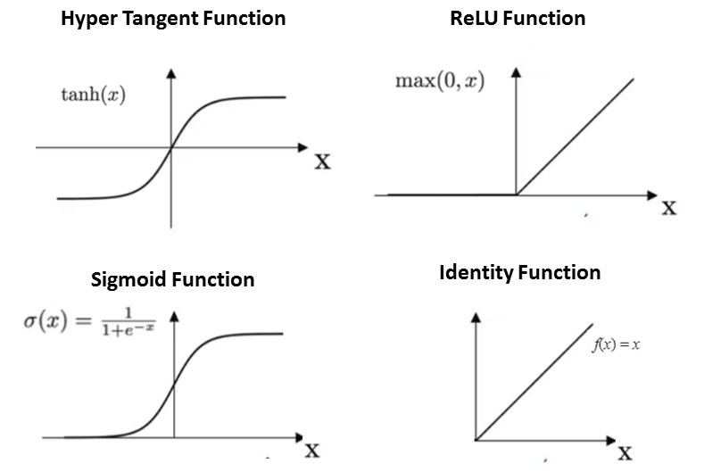
Activation Functions
(Rectified Linear Unit)
Activation functions introduce non-linearity
All neurons within same layer have the same activation function (layers are then usually named according to their activation function)
Data needs to be normalized to be within accessible range of the functions (e.g. from -3 to 3 for sigmoid activation function)
datacamp

Slide 29
Learning by Back-propagation and Gradient Descent
The cost function (e.g. RMSE, Cross Entropy) is the proxy for the error of the neural network. This function is continuous and smooth
Cost is minimized by optimizing the weight matrix during training
Cost gradients (differentiation of cost (and activation) function) for each variable in the weight matrix are first calculated in the output layer and then propagated back through the hidden layers
The cost gradient gives the change in the value of the cost when there is a small change in the weight
All weights are adjusted (in small steps) according to their cost gradients
Then cost gradients are recalculated and weights are readjusted iteratively, until the costs reach an acceptable level
Neural Networks are nested mathematical functions. Weights closer to the output layer are less nested than weights far from the output layer. Gradients computed at the output layer are passed back through layers multiplying with local gradients (Can lead to vanishing gradients when many layers are present)
The learning rate hyperparameter determines the sizes of the weight adjustments. Too small and it will take too long to optimize, or algorithm might get stuck in local minimum, too large and minima might be missed

Slide 30
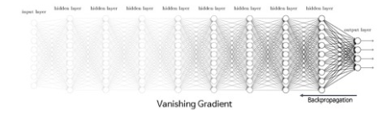
Vanishing Gradients
For many of the activation functions, cost gradients are less than 1
If multiplied together during back-propagation, the gradient disappears with too many hidden layers, and learning in layers close to the input layer becomes negligible -> It is better not to use too many hidden layers (Which also reduces the risks of overfitting due to too many variables)

Slide 31
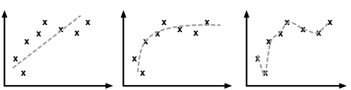
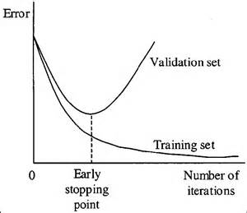
Validation to Prevent Overfitting
A part of the data is removed from the training data set to validate the training
Overfitting is present when the error of the validation set increases while the error of the training set further decreases (Marking the transition from learning to memorizing)
Overfitting can (for example) be reduced by adding additional restraints using regularization methods: The sum of (squares of) all weights are minimized together with the cost function

Slide 32
Neural Network for City Data Classification
Hidden and output layers are sigmoidal layers
Output neurons give values between 0 and 1 (Sigmoid Activation Function), which can be regarded as corresponding to the probability for a data point belonging to a certain cluster

Slide 33
Resulting Neural Network
PC2 is weighted most for hidden layer

Slide 34
Neural Networks for City Data Classification
Test data (NYC, Tehran, Karachi & Shanghai) was removed from training data
Tehran
NYC
Karachi
Shanghai

Slide 35
A Neural Network with more Neurons

Slide 36
Neural Networks for City Data
Complexity does not necessarily increase the power of the prediction by a lot
(Prediction success also varied between runs)

Slide 37
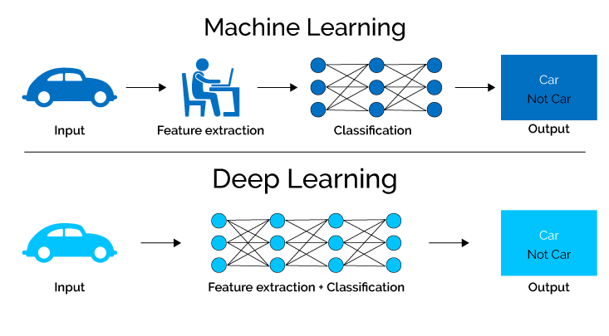
Deep Learning
Deep learning algorithms are based on neural networks, but have a more complex architecture
Deep learning is much better suited to handle unstructured data, temporal/sequential relationships and spatial relationships
XenonStack

Slide 38
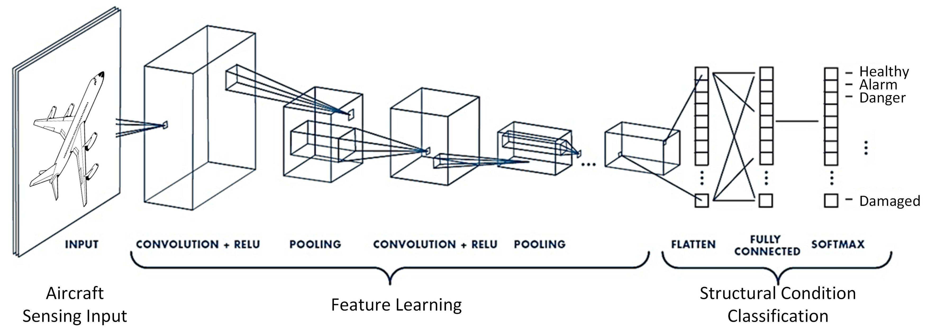
Convolutional Neural Networks (CNNs)
CNNs are able to process spatial data using four main types of layers:
Convolutional Layer: Pixel data is transmitted in the form of small and overlapping subframes to single neurons
Pooling Layer: Compressing several neurons (without overlap) from convolutional layer into single neuron
Fully Connected Layer: Usually a neural network using also the ReLU activation function
Softmax Layer: Produces output for classification problems with probabilities (Sum of Softmax Layer equals 1)
Tabian, Fu & Khodaei (2019)

Slide 39
Convolutional Neural Networks (CNN) - CIFAR
CIFAR10 dataset contains 60’000 images from 10 different classes. 50’000 of the images are used for training and 10’000 for validation. Each picture has 32x32 pixels.
Example is based on the packages tensorflow and keras. They can be used with R, but they run calculations in python
There were problems with the M1 chip and I had to use windows for this example

Slide 40
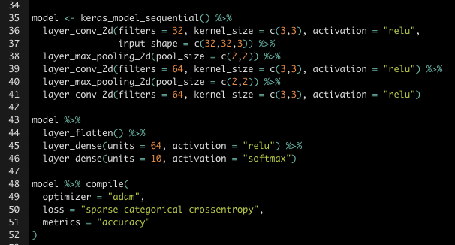
CNN - 1
The Architecture of this CNN:
Conv. (3x3) -> Max Pooling (2x2) -> Conv. (3x3) ->
Max Pooling (2x2) -> Conv. (3x3) ->
Flat Layer -> ReLU Layer (64 neurons) ->
Softmax Layer (10 neurons)

Slide 41
CNN - 1
The classification of the validation data doesn’t improve anymore after a few steps, whereas the training data still does, indicating memorizing instead of learning

Slide 42
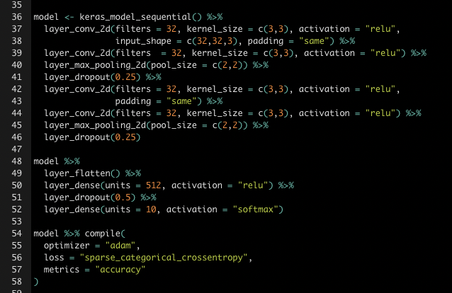
CNN - 2
This CNN was slightly more complex:
Conv. (3x3) -> Conv. (3x3) -> Max Pooling (2x2) -> Conv. (3x3) -> Conv. (3x3) -> Max Pooling (2x2) -> Flat Layer -> ReLU Layer (512 neurons) ->
Softmax Layer (10 neurons)
With Dropouts to improve learning -> Some nodes in hidden layers are randomly dropped in every learning iteration

Slide 43
CNN - 2
The more complex CNN seems to work much better when compared to the validation data. The overall accuracy is around 70%, which seems good for just a few lines of code.

Slide 44
Thank you for your attention!

